Slide 1
1 meter of elevation head
1 meter
Reference elevation
1 meter of pressure head
1 meter of velocity head

Slide 2



Calibrate at max flow

Slide 3

Sutro Weir
LFOM

Slide 4



Slide 5



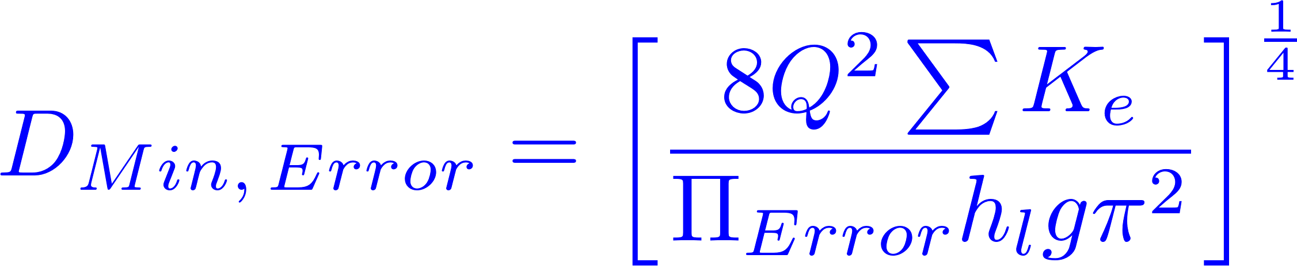



Slide 6

Small diameter tubing

Slide 7


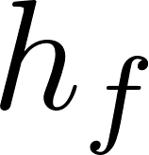
Air vent
Tube from the stock tank
Float valve
Holes to choose the dose
Flexible tube
Raw water
Rapid Mix
Orifice

Slide 8
V_{in}
V_{out}
A_{in}
x
A_{out}
in
out

Slide 9

Horizontal orifice
Vertical orifice

Slide 10
Overhead Tank
Constant head orifice
Overflow pipe
Pump

Slide 11
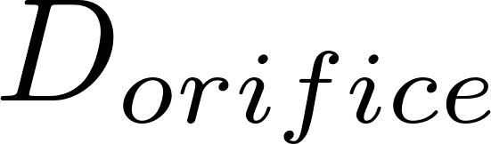
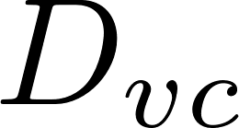
A
B

Slide 12
Pipe stub
Pipe coupling
Drain piping

Slide 13

AutoCAD drawing of sedimentation tank, don’t worry if this is confusing!
You’ll learn about it in depth later on.
Sedimentation
tank drain

Slide 14
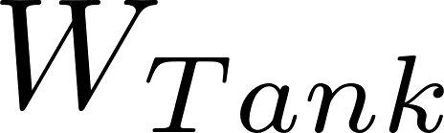
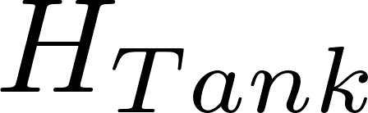
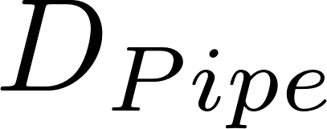
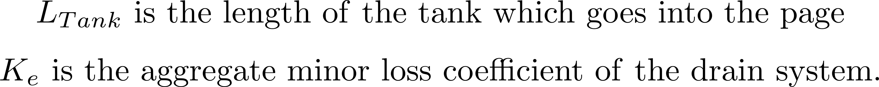

Slide 15

Float
Float
Orifice
Orifice
Transparent flexible tube
Transparent flexible tube

Slide 17
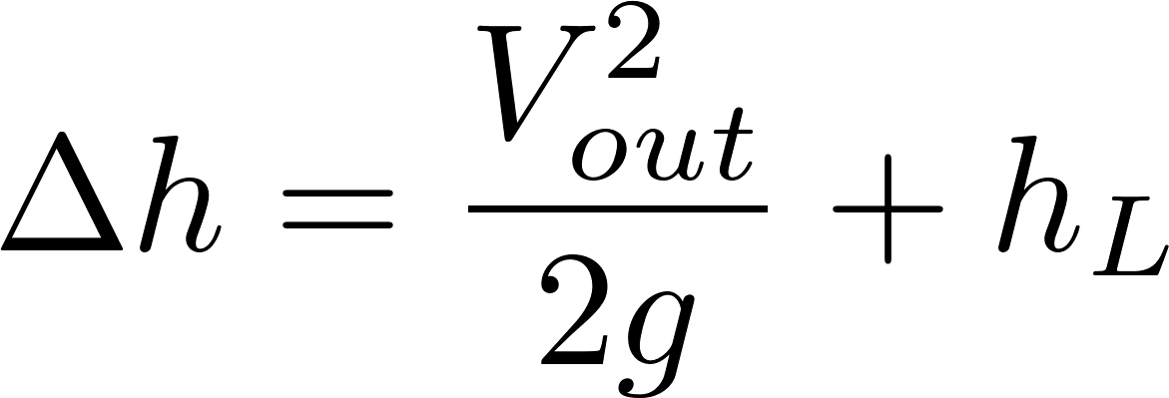
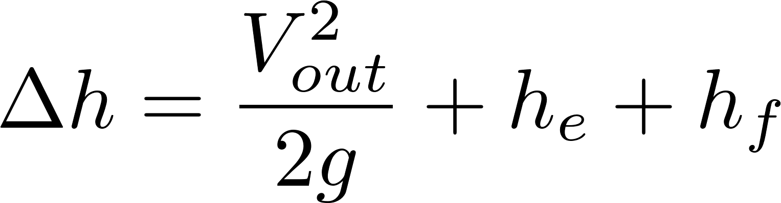
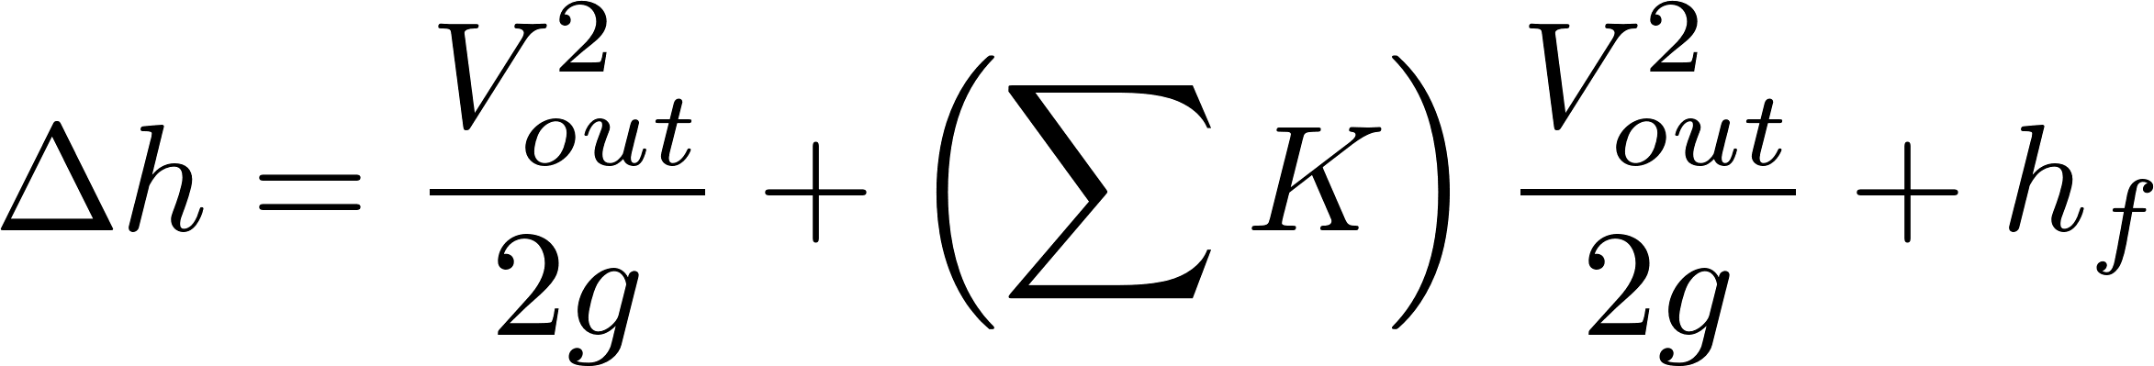
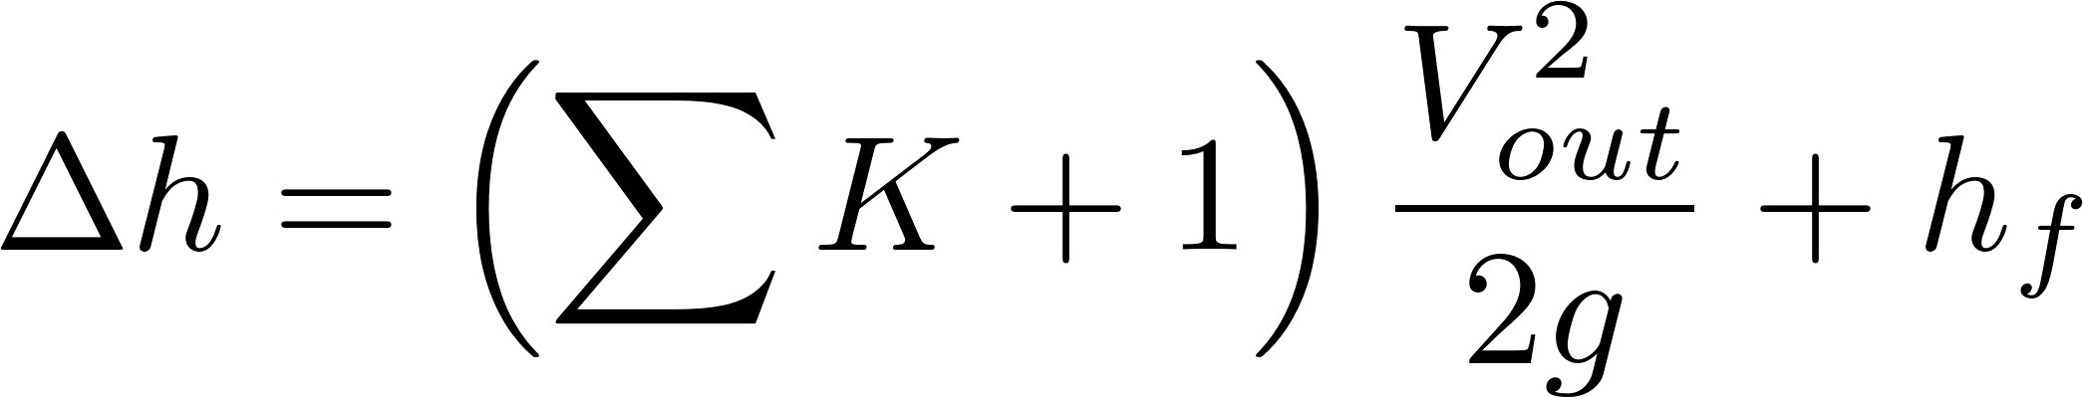
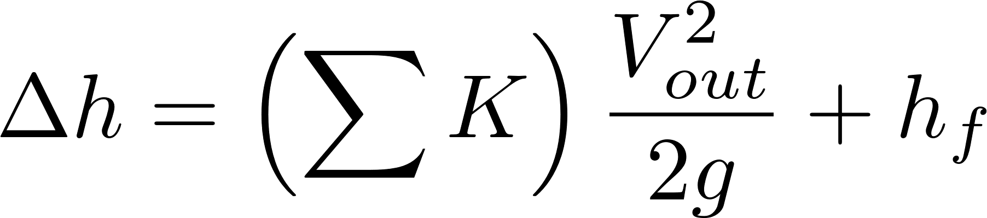
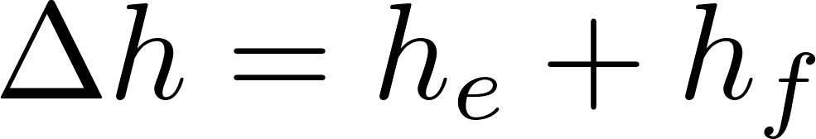

Simplified
energy equation
Just adding
K = 1 to the sum

Slide 18
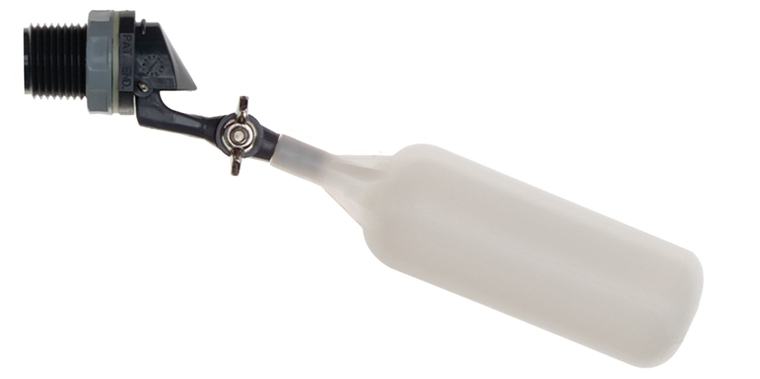
Flow of water
out of valve
Range of
motion of float
Float

Slide 19
C
B
A

Slide 20
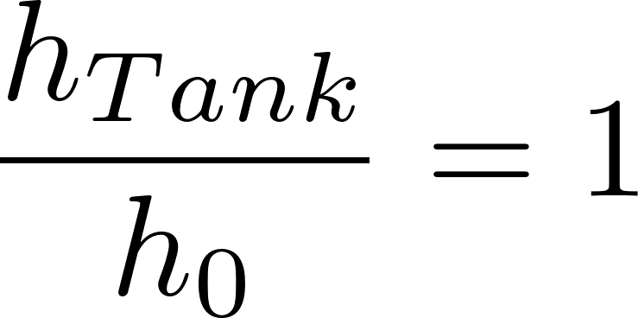
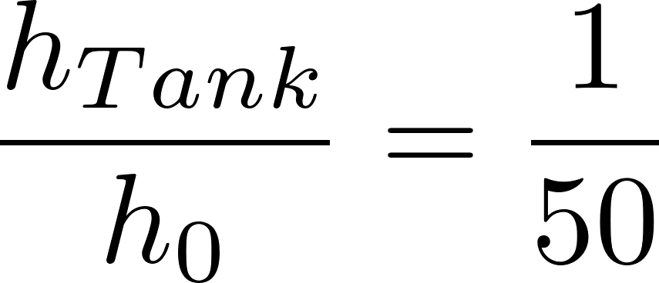
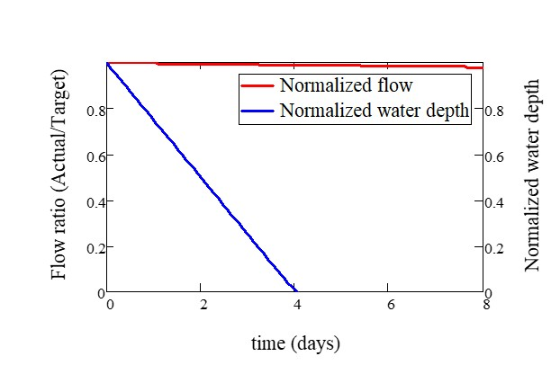
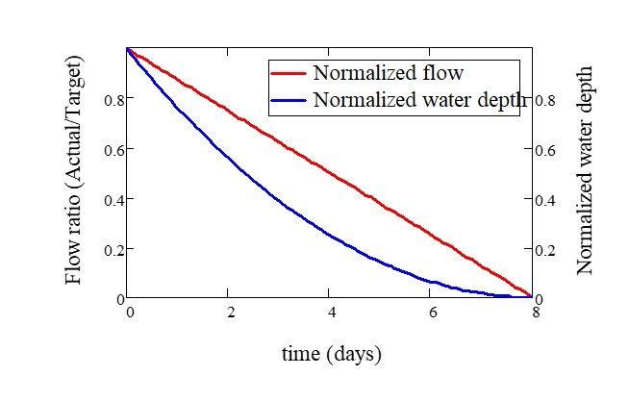

Slide 21


Tank
Valve
Water source pipe
Tank
Valve
Water source pipe

Slide 22
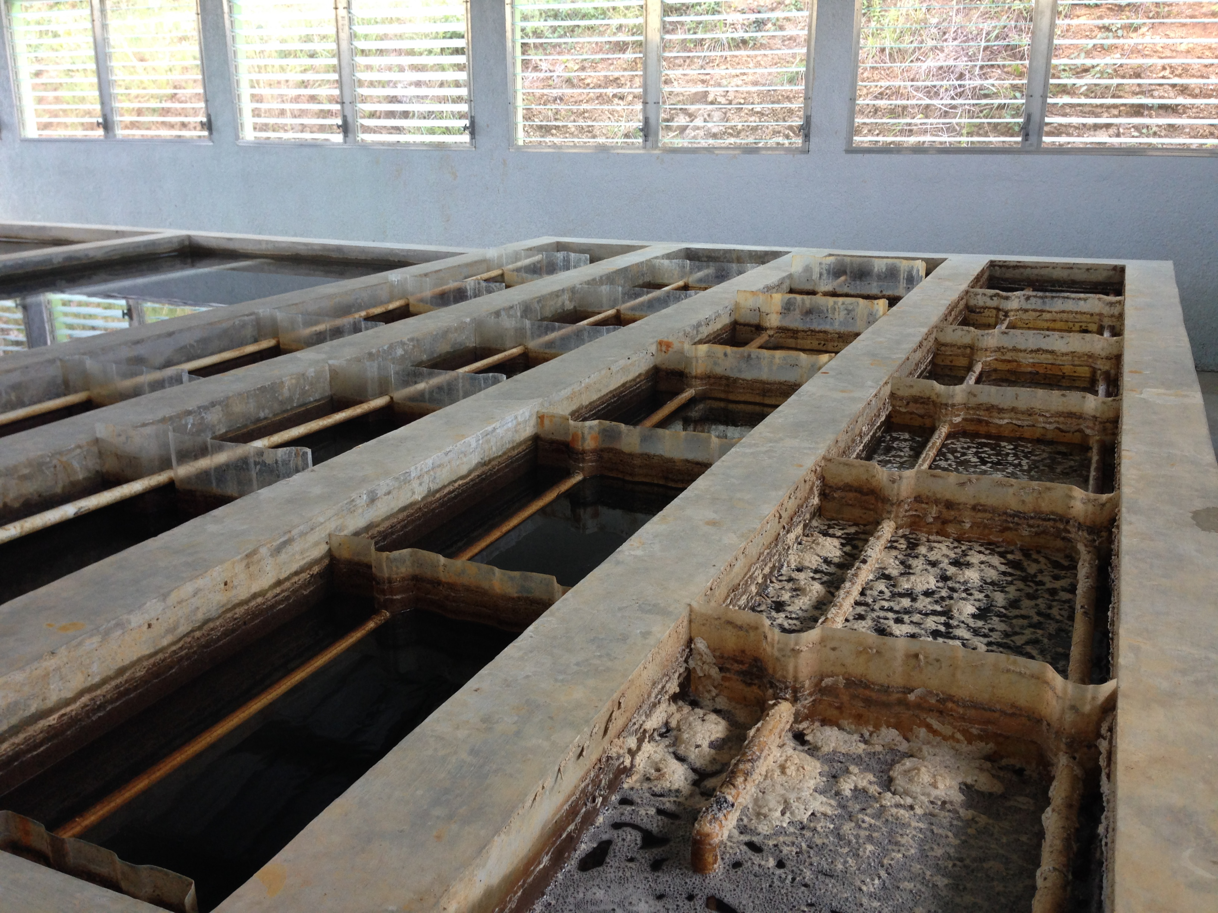
AguaClara Flocculator
Top Baffles
Bottom Baffles, underwater

Slide 23
AguaClara Flocculator

Slide 24


AguaClara Flocculator
Top and Bottom Baffles
Top Baffles
Bottom Baffles, underwater
Flocculator Channels
Flow Path

Slide 25

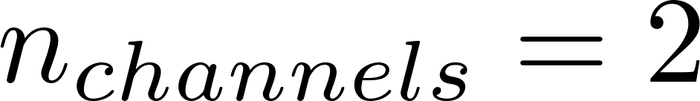
Flocculator
Channels
There are an even amount of flocculator channels to keep the AguaClara plant layout consistent. This ensures that the entrance tank, filter box, and filters can be kept in the same places across plants. Only for exceptionally low flow plants (< 5 LPS) is there one channel.

Slide 26

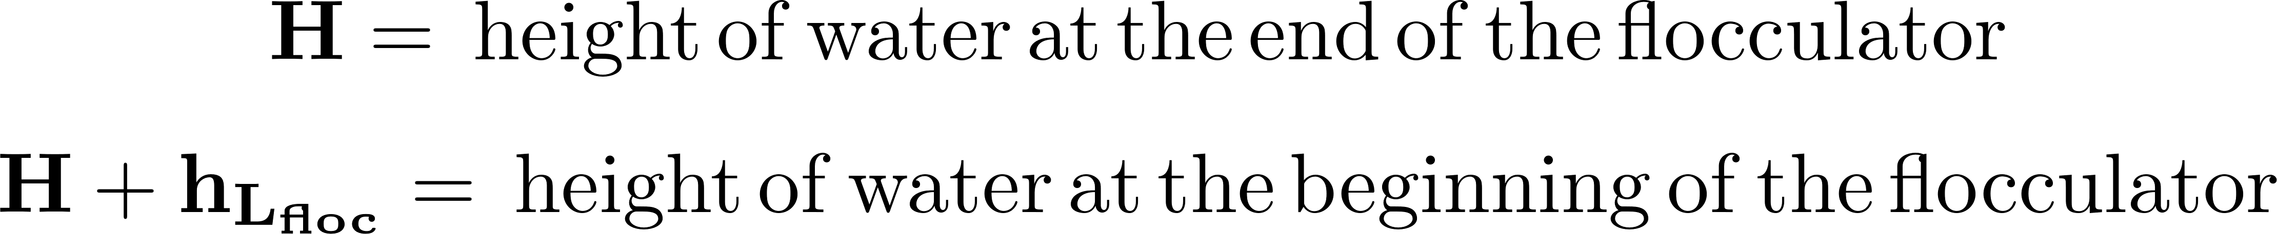
Sedimentation
Tanks (3)

Slide 27








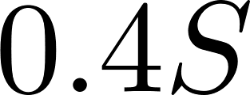
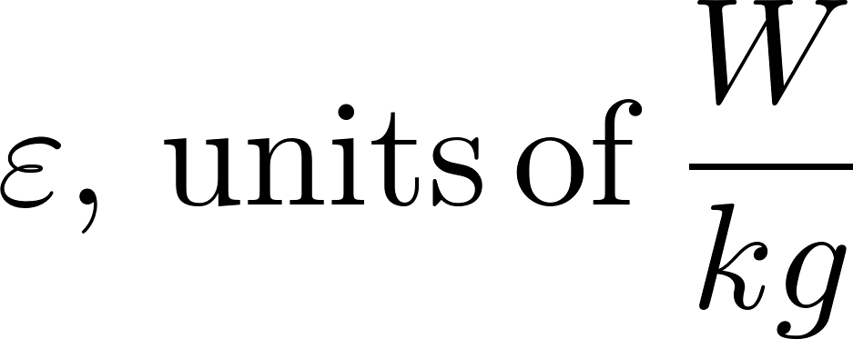
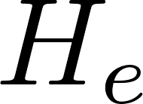
Dead Space,
lowers G

Slide 28


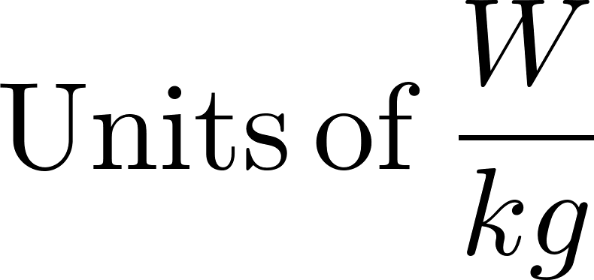

Slide 29


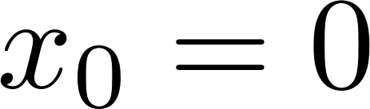
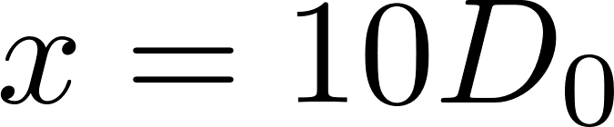
Jet expansion
after a baffle
Jet expansion rule of thumb

Slide 30





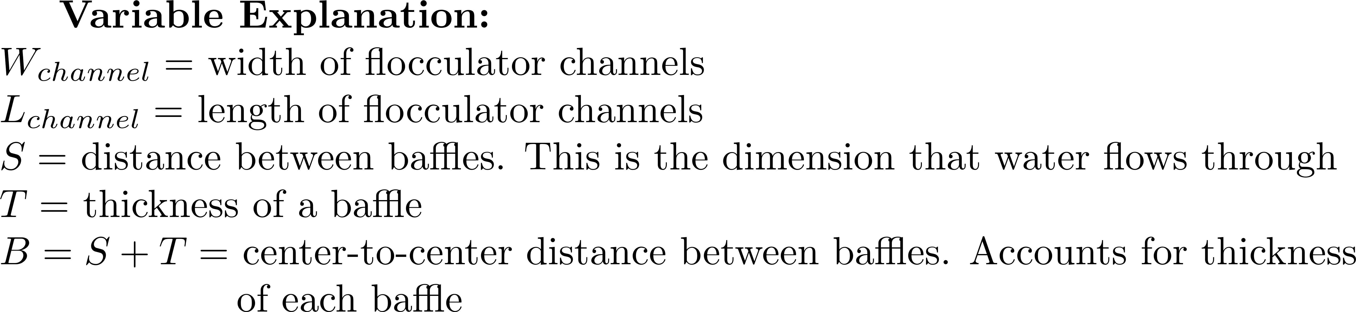
Top Baffles
Water
flow path
Side-view
Bottom Baffles
Plan-view

Slide 31
Top Baffles
Water
flow path
Vertical
Flocculator:
Side-view
Bottom Baffles
Plan-view

Slide 32

Set of obstacles,
3 per baffle in this design
Top baffles
Single obstacle
Bottom baffles

Slide 33

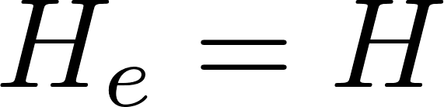
No obstacles
1 obstacle
per baffle
Water
flow path
Water
flow path
Obstacles

Slide 34
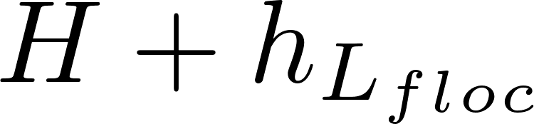
Area unaccounted for in the initial volume calculation. This makes θ_{actual} greater than the design θ. However, we do not believe that this extra ‘triangle’ of space has significant G values, and therefore we do not believe that it adds any collision potential to the design.
This image is just to show how water level decreases throughout a flocculator.
Standard AguaClara flocculators have at least two channels.

Slide 35



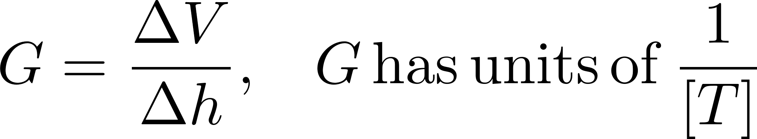

Slide 36
Pressure
Shear (wall on fluid)
Velocity

